Slide 1

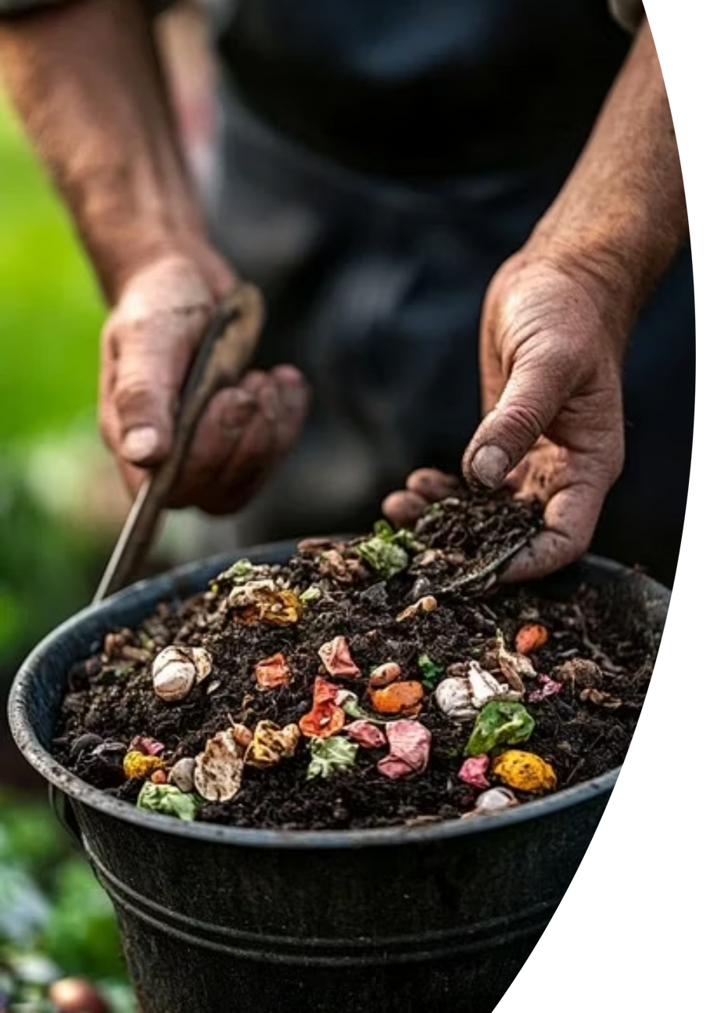
BanglaKompost
Turning Market Waste into Soil Wealth
Dhaka, Bangladesh
Notes:
1

Slide 2
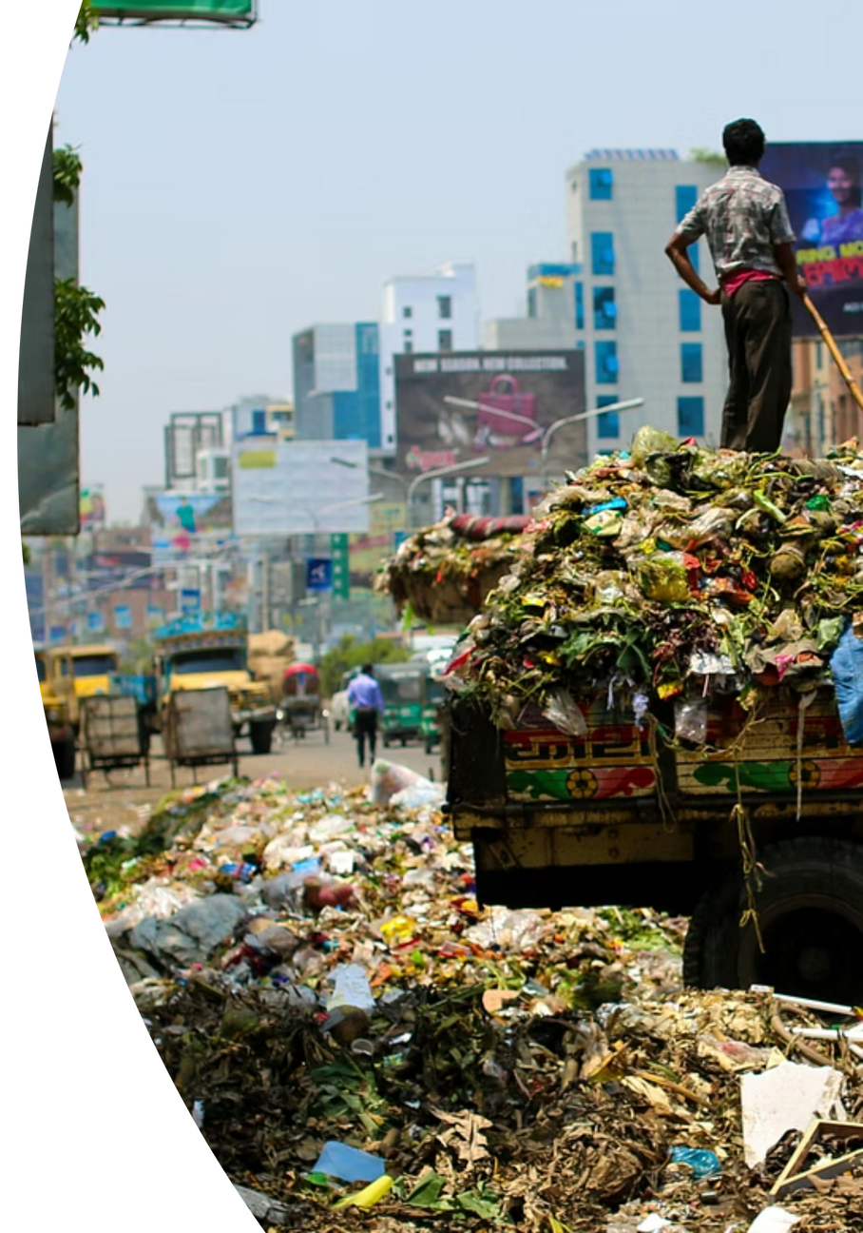
Meet Karwan Bazaar
Through Rahim's Eyes
Every morning, Rahim arrives at Karwan Bazar before sunrise.He sweeps the floors while vendors unload fresh vegetables. But by afternoon, Rahim’s job becomes harder. Unsold fruits and vegetables pile up, rot under the sun, and fill the air with a sharp smell. Flies swarm, drains clog, and his hands touch waste that was once food. Rahim cleans every day, but the waste returns—bringing sickness, shame, and exhaustion. For him, this is not just waste; it’s a daily struggle to keep his workplace livable.
Notes:
2

Slide 3
The Problem
5,000+ Tons Daily
Environmental Hazard
Wasted Resource
Dhaka generates over 5,000 tons of waste daily, with most ending up in open dumps like Mugda.
Rotting organic waste releases methane, pollutes groundwater, and creates breeding grounds for disease.
60% of this waste is organic and could become valuable compost instead of pollution.
Notes:
3

Slide 4
The Unsorted Waste Cycle
Daily Market Waste
Unsold produce accumulates
Dumping
Waste disposed in landfills
Pollution
Environmental contamination spreads
Methane Emissions
Greenhouse gases released
Soil Degradation
Land quality declines
Chemical Dependency
Farmers resort to expensive fertilizers
Notes:
4

Slide 5



Our Solution
From Waste to Wealth in 3 Steps
Collect
Compost
Grow
We collect organic waste from households, markets, and restaurants with just one click or call.
Waste is processed at our facility using scientific composting methods within 30-45 days.
Premium organic compost is delivered to farmers and gardeners for healthier, sustainable agriculture.
Notes:
5

Slide 6






What BanglaKompost Provides
Market-Level Waste Collection
Organic Compost Production
Affordable Soil Nutrients
Accessible organic fertilizer for farmers
Systematic collection from Dhaka's major markets
High-quality, nutrient-rich compost from market waste
Community-Driven Operations
Environmental Protection
Local employment and community empowerment
Reduced emissions and soil restoration
Notes:
6

Slide 7








Business Model
Local Market Vendors & Households
Waste Collection
1
Sell organic waste @ 1-3 ৳/kg
2
Daily pickup, manual sorting (Initially)
6
Revenue Generated
Local Composting Hub
Reinvest in jobs, hubs & scaling
3
30–45 days controlled composting
5
Farmers & Gardeners
4
Organic Compost Ready
Affordable, eco-friendly fertilizer
Bottling and market preparation
Raw Material
Core Product
Cost Advantage
Impact
Market vegetable waste
Organic compost
Low-cost inputs
Cleaner markets, healthier soil
Notes:
7

Slide 8
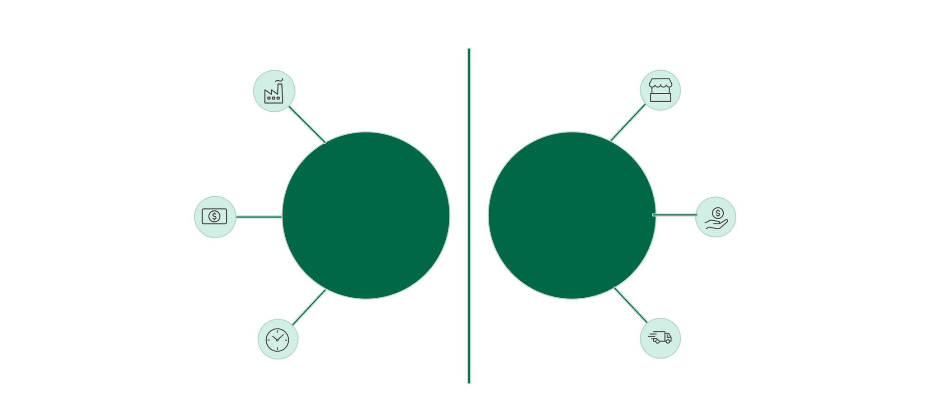






How We're Different
Centralized operations
Local market collection
Traditional
Bangla
No payment for waste
Pays for waste
Systems
Kompost
Slow & costly
Fast Pickups
Notes:
8

Slide 9
Our Roadmap
Launch Pilot
Introduce Liquid Fertilizer
Scale Across Bangladesh
Single-market composting pilot at any local market
Expand operations to other cities and regions
Diversify product line with liquid organic fertilizer
1
2
3
4
5
Expand to Five Markets
Partner with Municipalities
Scale collection and composting operations across Dhaka
Establish official waste management partnerships
Notes:
9

Slide 10
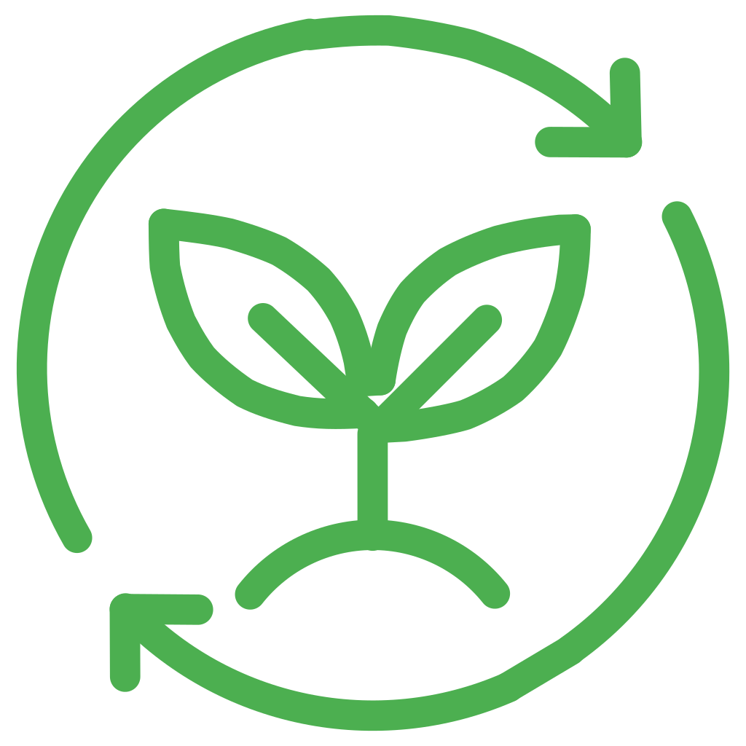





Our Impact
SDG 11: Sustainable Cities
Waste Diverted
Creating cleaner, healthier urban environments in Dhaka through efficient waste management.
5460 tons of organic waste is produced every year in just 1 sq km of Dhaka Mega City.
SDG 12: Responsible Consumption
Compost Produced
Promoting sustainable production and consumption patterns within the community.
273 tons of nutrient-rich organic compost created, enhancing soil health. It's Just 5% of total waste of 1 sqkm in Dhaka.
SDG 13: Climate Action
Farmers Supported
Reducing methane emissions and our overall carbon footprint for a greener future.
Initially 300 farmers and gardeners will be benefiting from affordable, high-quality organic fertilizer in one year by us.
Notes:
10

Slide 11
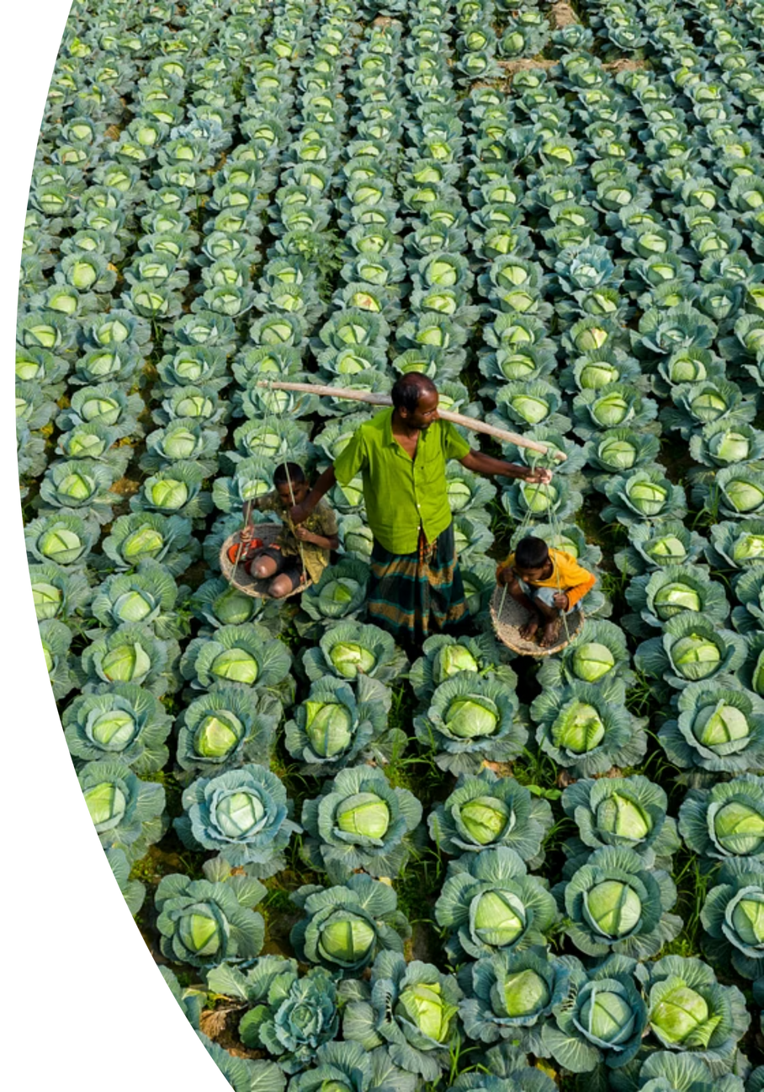
Our Vision
Turning Market Waste into Soil Wealth
At BanglaKompost, we envision a Bangladesh where market waste becomes a resource, not a burden. By transforming organic waste into compost, we create green jobs, support vendors and farmers, restore soil health, and build cleaner, more resilient communities—starting in Dhaka and scaling across the country.
Notes:
11

Slide 12
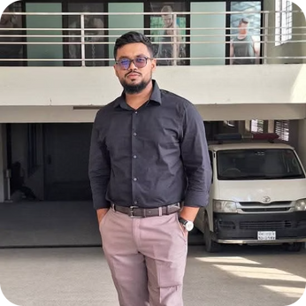
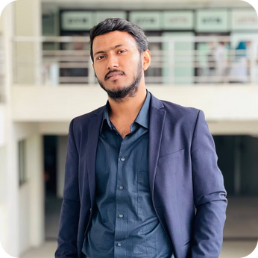
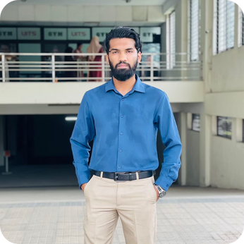
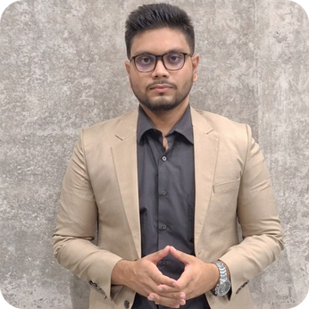
Our Team
Md. Rashedul Islam Jubayer
Dipen Kumar Das Dhrubo
Imam Hossain Jawad
MD. Rahmatulla Ashik
Marketing, Brand & Community
Business Development & Partnerships
Operations & Supply Chain
Product, Technology & Website
Notes:
12

